Slide 1
Talent Development
At HCL

Slide 2
Locator - XPATH

Slide 3
XPATH
XPATH is one of the locator technique.
XPath is defined as XML path. It is a syntax or language for finding any element on the web page using XML path expression.
If the elements are not found by the general locators like id, class, name, etc. then XPath is used to find an element on the web page.
It provides very effective ways of locating web elements.
XPATH features
User has the option to customize the XPATH
User can use XPATH expressions like Contains(), Logical Operators like AND & OR
User can use functions like Start-with(), Text() etc.

Slide 4
XPATH - Types
There are 2 types of XPATHs.
Absolute XPATH
Absolute Xpath starts with the root node and is prefixed with a “/”.
The advantage is – it identifies the element very fast.
Disadvantage is - if any thing goes wrong or some other tag added in between, then this path will no longer works.
Relative XPATH:
A relative xpath is one where the path starts from the node of user choise.
It starts with a double slash “//”
Advantage of using relative xpath is, there is no need to mention the long xpath, you can start from the middle or in between.
Disadvantage here is, it will take more time in identifying the element as user specify the partial path and not exact path.
If there are multiple elements for the same path, it will select the first element that is identified

Slide 5
XPATH – How to find
There are multiple ways to find the XPATH
Using Firepath/ Firebug Technique
Using Selenium IDE
User can create it - Customization

Slide 6
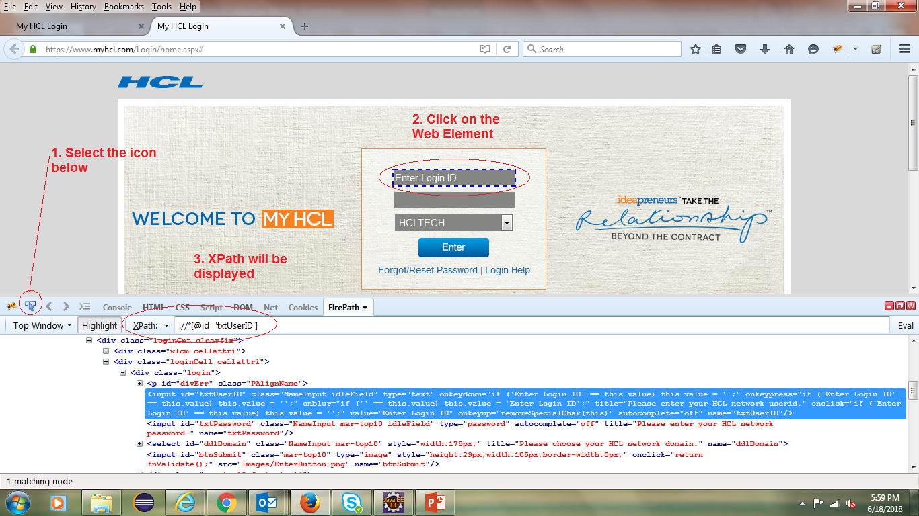
XPATH – How to find
Firepath/ Firebug:

Slide 7
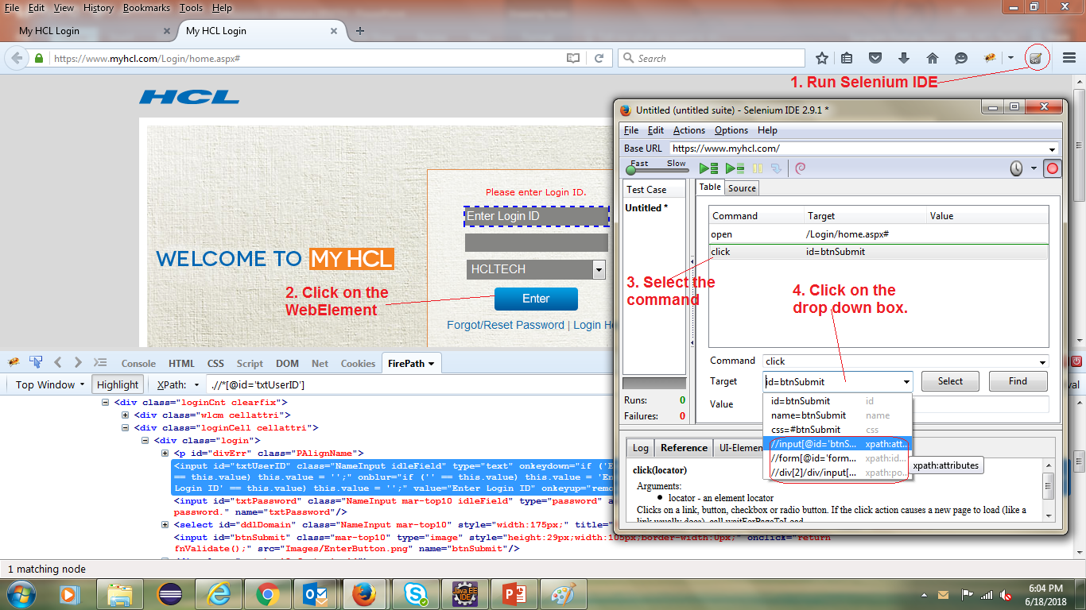
XPATH – How to find
Using Selenium IDE Tool

Slide 8
XPATH Syntax
//tagname[@attribute=‘value’]

Slide 9
XPATH
Hands on - http://demo.guru99.com/v1/ (Absolute/ Relative xpaths)
User ID field
HTML Code - <input type="text" onblur="validateuserid();" onkeyup="validateuserid();" maxlength="10" name="uid"/>
Simple xpath for user ID field are
//input[@type='text']
//input[@name='uid']
//input[@maxlength='10']
Login Button
Simple xpath are
//input[@type='submit']
//input[@value='LOGIN']
//input[@name='btnLogin']

Slide 10
XPATH
Using tag as class “Gtpl Bank” field
HTML code is <h2 class="barone">Gtpl Bank</h2>
If there is no tagname or you don’t want to use one, use the * operator.
XPATH is //*[@class='barone']
//a[@href='http://demo.guru99.com/'] for the link “here”

Slide 11
XPATH – Contains()
Contains() – used when value of any attributes changes dynamically.
Syntax - //tagname[contains(@attribute,’value’)]
It has ability to find element with partial text.
Submit button - //*[contains(@type,'sub')]
Now let’s check the name field of both Login and Reset
Xpath - //*[contains(@name,'btn')] will highlight both.
For link text “Here” - //*[contains(text(),'here')] or //*[contains(@href,'guru99.com')]

Slide 12
XPATH – Using Or & And
OR
In Or expression, two conditions are used.
At least, one of the conditions should be TRUE or may be both to find the element.
Let’s consider this XPATH - //*[@type='submit' OR @name='btnReset']
AND
In AND expressions, two conditions are used.
Both have to be true for finding the element.
Let’s consider this XPATH - //*[@type='submit' AND @name='btnLogin']

Slide 13
XPATH – Starts-with
Start-with function finds the element whose attribute value changes on refresh or any operation on the webpage
In this expression, match the starting text of the attribute is used to find the element whose attribute changes dynamically
Whenever we have multiple attributes and the start text is the same, then we should use it.
Syntax - //tagname[starts-with(@attribute,'value')]
Example - //label[starts-with(@id,'message')]
Example – Amazon web search

Slide 14
XPATH – Text()
In this expression with text() functions, we will find the element with exact text match.
Syntax - //Tagname[contains(text(),‘Text')]
For user ID field - //td[text()='UserID']
For password - //td[text()='Password']

Slide 15
Code

Slide 16
Code – Locator xpath
package Session_2_locatorTechnique;
import org.openqa.selenium.By;
import org.openqa.selenium.WebDriver;
import org.openqa.selenium.firefox.FirefoxDriver;
public class locator_XPATH {
public static void main(String[] args) {
// TODO Auto-generated method stub
String url = "https://www.myhcl.com/Login/home.aspx";
WebDriver myHCL_WD = new FirefoxDriver();
myHCL_WD.get(url);
myHCL_WD.findElement(By.xpath(".//*[@id='txtUserID']")).sendKeys("Sangram.Swain");
myHCL_WD.findElement(By.xpath(".//*[@id='txtPassword']")).sendKeys("Password");
myHCL_WD.findElement(By.xpath(".//*[@id='ddlDomain']")).sendKeys("HCLTECH");
myHCL_WD.findElement(By.xpath(".//*[@id='btnSubmit']")).click();
}
}

Slide 17
Code –xpath - customization
import org.openqa.selenium.By;
import org.openqa.selenium.WebDriver;
import org.openqa.selenium.firefox.FirefoxDriver;
public class xpath_customization {
public static void main(String[] args) {
String baseURL = "https://www.myhcl.com/Login/home.aspx";
WebDriver myHCL_WD = new FirefoxDriver();
myHCL_WD.get(baseURL);
/*
* Now look at the HTML coding of the Login Field.
* <input id="txtUserID" class="NameInput focusField" type="text" onkeydown="if ('Enter Login ID' == this.value) this.value = '';"
* onkeypress="if ('Enter Login ID' == this.value) this.value = '';" onblur="if ('' == this.value) this.value = 'Enter Login ID';"
* title="Please enter your HCL network userid." onclick="if ('Enter Login ID' == this.value) this.value = '';" value="Enter Login ID"
* onkeyup="removeSpecialChar(this)" autocomplete="off" name="txtUserID"/>
* Here the tagname is input
* Attribute is id, value, name
* So the XPATH can be //input[@id='txtUserID']
* or //input[@value='Enter Login ID' ]or //input[@name='txtUserID'] *
*/
//myHCL_WD.findElement(By.xpath("//input[@id='txtUserID']")).sendKeys("Sangram.Swain");
//myHCL_WD.findElement(By.xpath("//input[@value='Enter Login ID']")).sendKeys("Sangram.Swain");
myHCL_WD.findElement(By.xpath("//input[@name='txtUserID']")).sendKeys("Sangram.Swain");
}
}

Slide 18
Code –contains()
import org.openqa.selenium.By;
import org.openqa.selenium.WebDriver;
import org.openqa.selenium.firefox.FirefoxDriver;
public class xpath_contains_function {
public static void main(String[] args) {
String url = "http://demo.guru99.com/V4/";
WebDriver contains_WD = new FirefoxDriver();
contains_WD.get(url);
//Syntax for contains function is //tagname[contains(@attribute,’value’)]
/*Let's check the HTML code for Login and Reset button
// * For LOGIN - <input type="submit" value="LOGIN" name="btnLogin"/>
* For RESET - <input type="reset" value="RESET" name="btnReset"/>
* For Login, XPATH will be -
* //input[contains(@type,'submit')]
* //input[contains(@value,'LOGIN')]
* //input[contains(@name,'btnLogin')]
* */
contains_WD.findElement(By.xpath("//input[contains(@type,'submit')]")).click();
}
}

Slide 19
Code –starts-with(), text()
import org.openqa.selenium.By;
import org.openqa.selenium.WebDriver;
import org.openqa.selenium.firefox.FirefoxDriver;
public class xpath_contains {
public static void main(String[] args) {
String url = "https://www.myhcl.com/Login/home.aspx";
WebDriver myHCL_WD = new FirefoxDriver();
myHCL_WD.get(url);
myHCL_WD.findElement(By.xpath("//input[contains(@id,'UserID')]")).sendKeys("Sangram");
myHCL_WD.findElement(By.xpath("//input[starts-with(@id,'txtPass')]")).sendKeys("Password");
//<a onclick="Popup('https://globalit.hcl.com/selfservice/','HCLTIntranetForgotPassword',725,700);" href="#">Forgot/Reset Password</a>
//tagname[contains(text(),’Partial or Full value of text’)]
//a[contains(text(),'Reset Password')]
myHCL_WD.findElement(By.xpath("//a[contains(text(),'Reset Password')]")).click();
}
}

Slide 20
Code
Download the code from https://github.com/sangramkswain/HCLPuneTraining
File Name – Sessions.zip

